Slide 1
Capstone Project Hotel Booking Analysis By Amol Kale Ayushi Jain Mukund Pandit Sidharth Budhiraja Siddhesh Adhaukar

Slide 2
Index
Data Summary
Null Values Present In Dataset
Number of bookings cancelled and its percentages of cancellation
Which are the most trending months of hotel bookings ?
Monthly Bookings of Hotels
Meals ordered by customers
How long the peoples stayed in the hotel?
Which was the most booked accommodation type (Single, Couple, Family)?
What is the relation of deposits to the booking cancellation?
Lead Time vs Cancellation
Country-wise Hotel Booking
Market-segment wise hotel booking
Correlation Heat Map Between All Features
Average Daily Rate (ADR) comparision of city hotel and resort hotel.
Conclusion

Slide 3
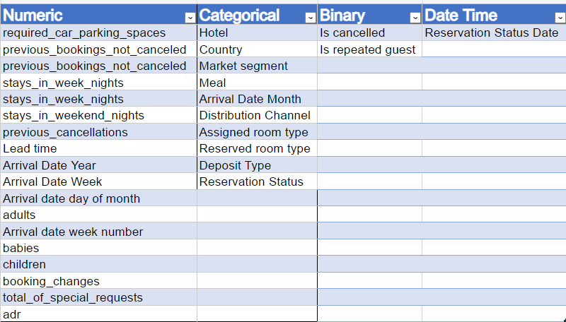
Data Summary

Slide 4
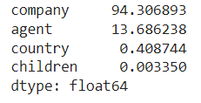
Null Values Present in Dataset
This Dataset consist four columns which contains null values.
For dealing with this null values we drop company and agent column because it contains large amount of Null values.
Country and Children contains very small amount of Null values so that we drop rows from these columns which contains null values.

Slide 5
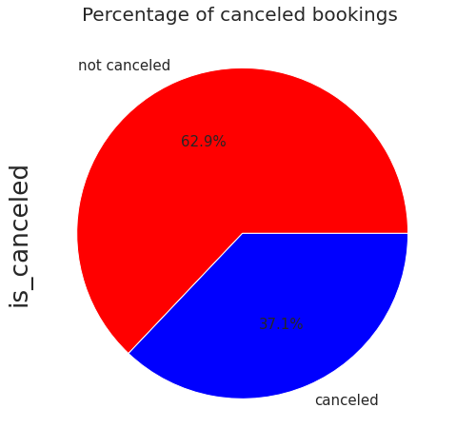
Number of bookings cancelled and its percentages of cancellation
From total number of bookings around 37.1 % bookings were cancelled.
Confirm bookings was around 62.9%.
Total bookings = 119210
Confirm bookings = 75011
Cancelled bookings = 44199

Slide 6
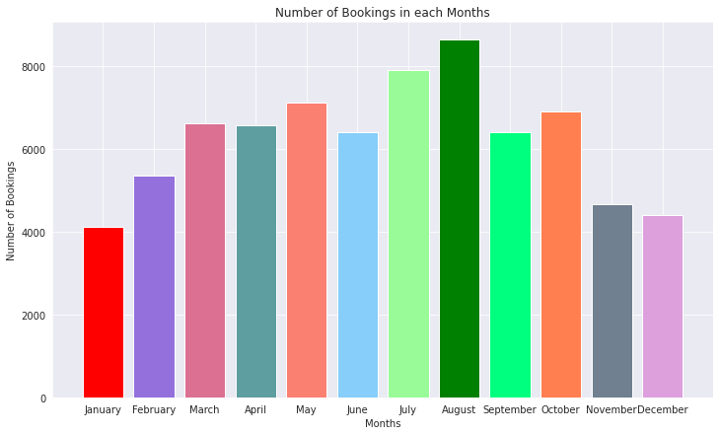
Which is the most trending months of hotel bookings ?
Number of Bookings in August and July month is more as compared to other months
From month march to October number of bookings was pretty good
Number of Bookings decreases in last months of the year

Slide 7
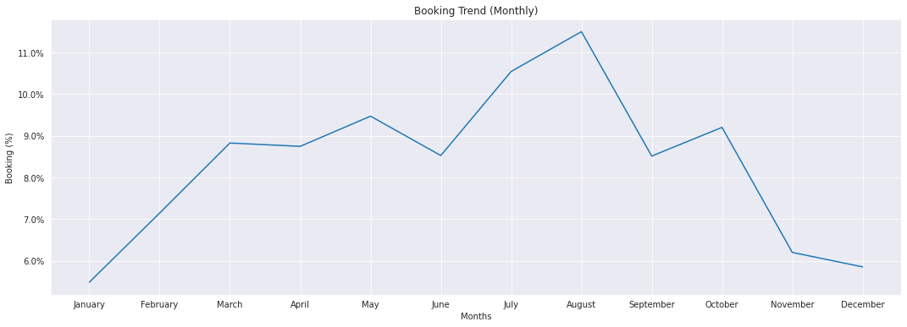
Monthly Bookings of Hotels
Number of bookings for resort hotel constant for March , April and may months.
For months may to September bookings for city hotel is more.

Slide 8
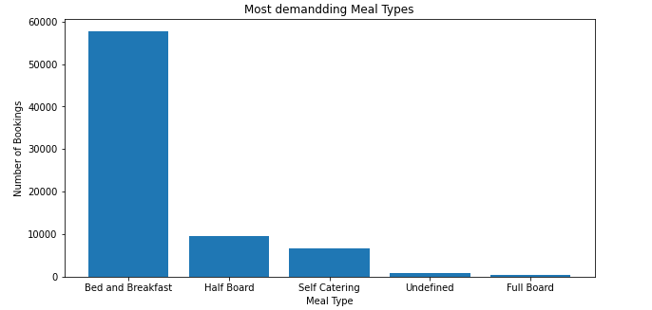
Meals ordered by customers
The above Bar Graph plot shows that ‘Bread and Breakfast’ was the most ordered meal type.

Slide 9
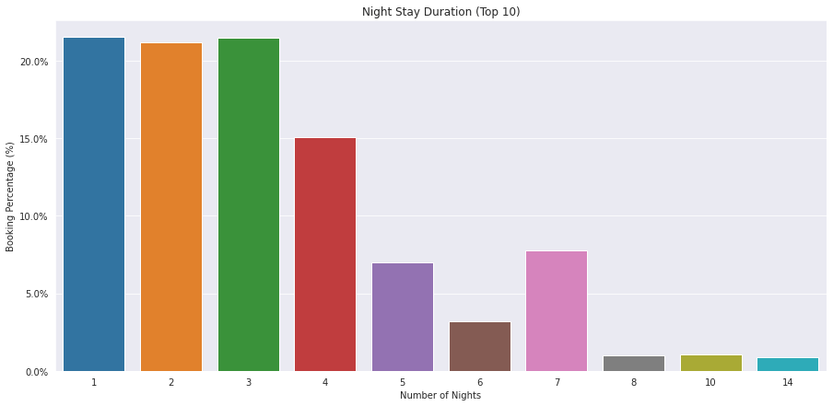
Most preferred stay duration
The above bar graph plot shows that most guests prefer to stay in the hotels for 1 ,2, 3 or 4 nights. There are considerable number of bookings for 7 nights stay.

Slide 10
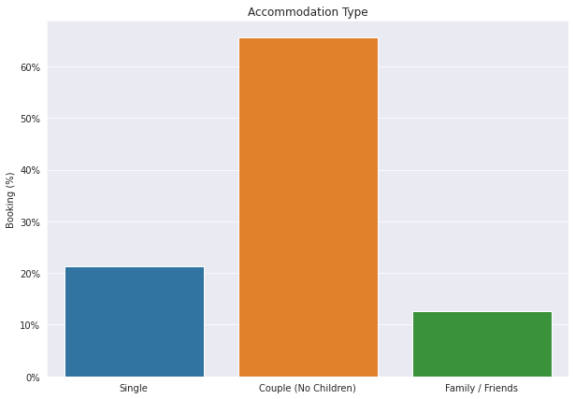
Which was the most booked accommodation type (Single, Couple, Family)?
1.Couple (or 2 adults) is the most popular accommodation type.
2.So hotels can make plans accordingly

Slide 11
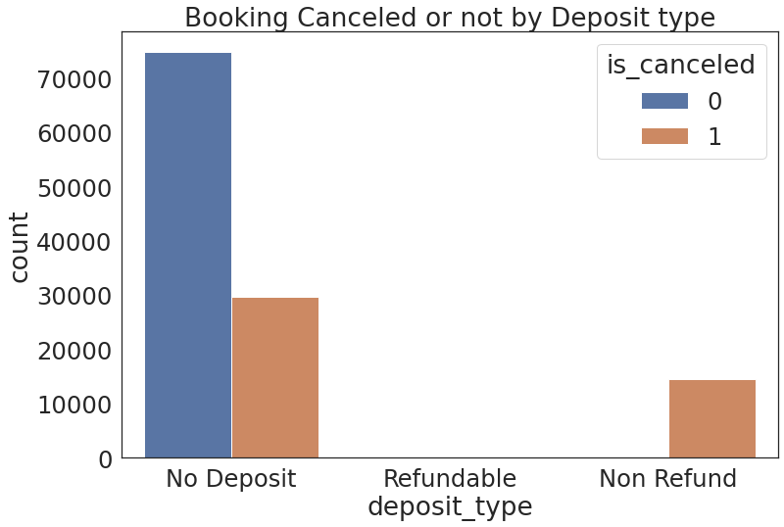
Relation of deposits to the booking cancellation
No deposit cancellations are high compared to other categories

Slide 12
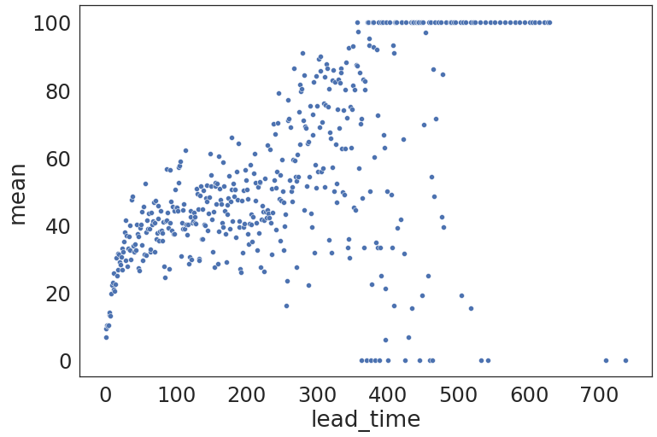
Lead Time vs Cancellation
From the above scatter plot, we can see that the higher lead time has higher chance of cancellation. We have plotted lead_time in X direction and the mean of is_cancelled groupby lead_time in Y direction.

Slide 13
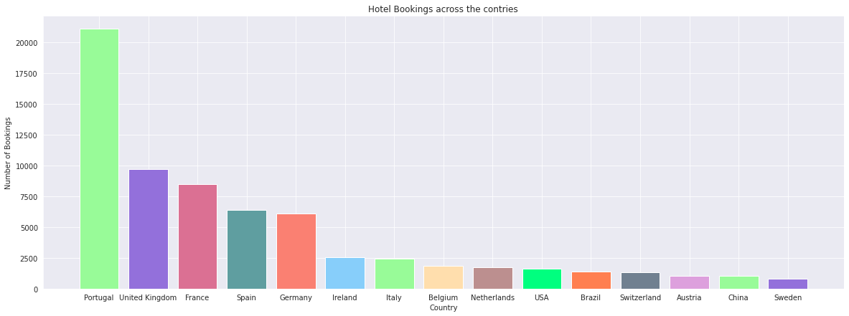
Country-wise Hotel Booking
Guests where coming from all over the world throughout the year from 2015 to 2017. The above bar graph shows the top 15 countries from where the guests come. Portugal brings in the mosts numbers of guests.

Slide 14
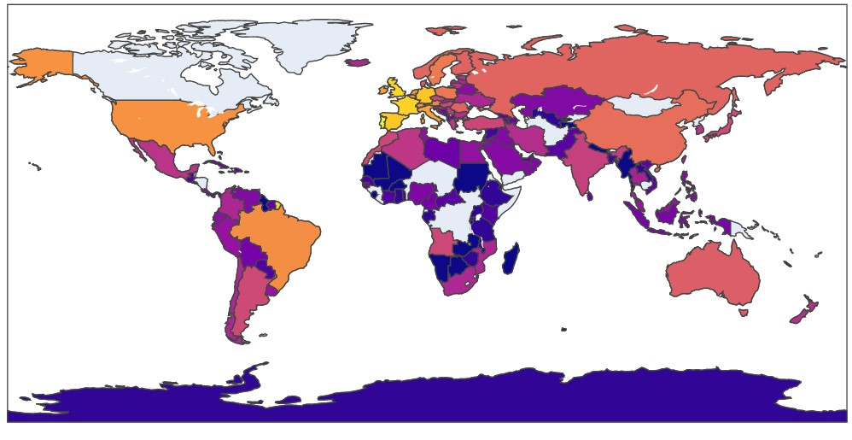

The above choropleth map shows that the European region collectively brings in the most number of bookings and the African region collectively brings in the least number of bookings.

Slide 15
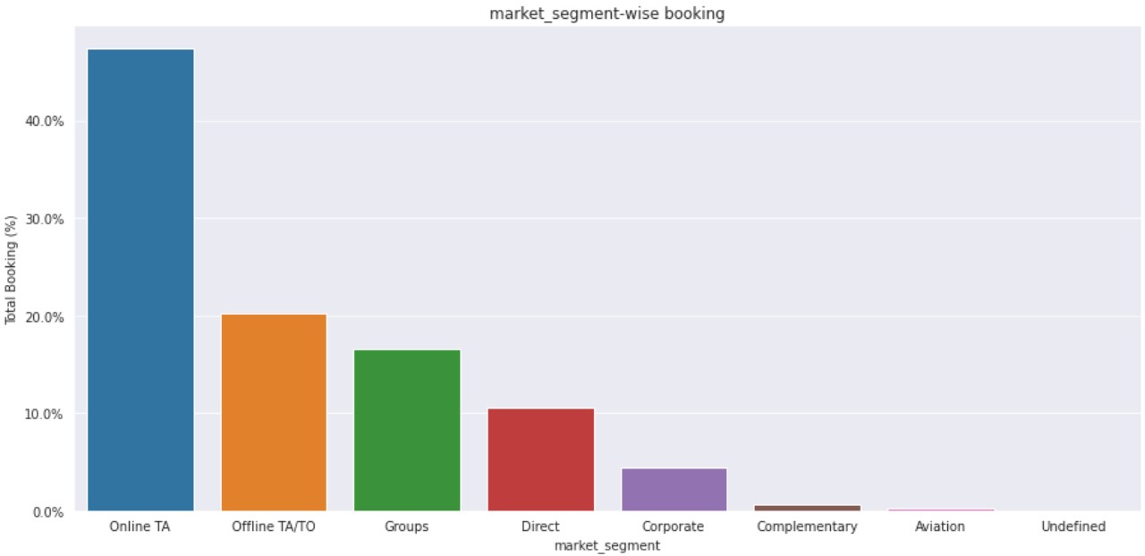
Market Segment-wise Hotel Booking Percentage
Inference: Online Travel Agents brings in more than 40% of the total bookings, followed by the Offline Travel Agents/Tour Operators brings in more than 20% of the total bookings.

Slide 16
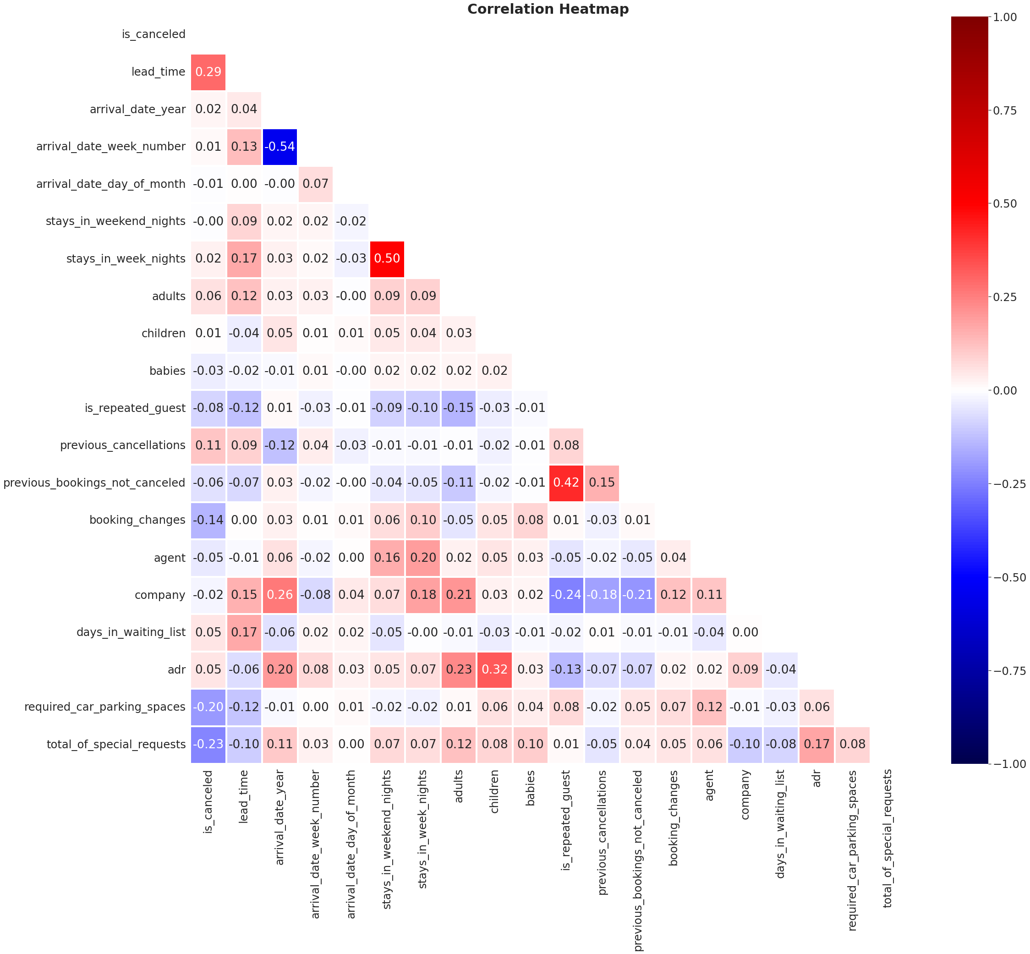
Correlation Heat Map Between All Features
Correlation Conclusion:
arrival_date_week_number and arrival_date_year are 54% negative correlated.
previous_bookings_not_cancelled and is_repeated_guest are 42% positive correlated.
Adr and children are positive correlated by 33%.

Slide 17
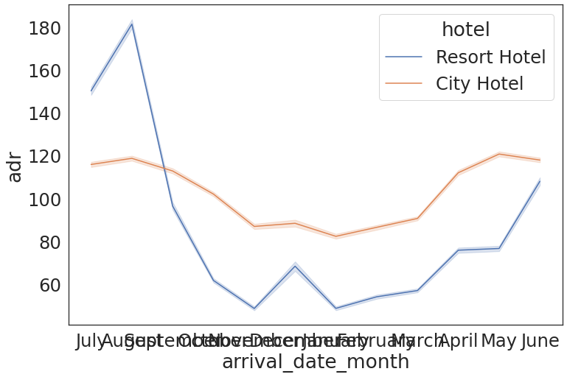
Average Daily Rate (ADR) comparision of city hotel and resort hotel.
Average Daily Rate (ADR) for the months of July and August are strikingly more for the Resort Hotel than the City Hotel.

Slide 18
Conclusion:
'August' month has highest number of hotel bookings whereas 'January' records the least.
Guests from PRT(Portugal) have got the maximum number of hotel bookings.
Its observed that 'City hotels' were more cancelled as compared to 'Resort hotels'.
'Online TA' brings maximum bookings.
'August' has got the highest average ADR in each year.

Slide 19
Conclusion: (Continue)
Its found that 77.3% of customers prefers BB(Bread & Breakfast).
Its observed that most of the customers rather guests do not repeat their bookings.
We can observe that in city hotels highest room ADR was for room type G and was lowest for the room type K. In case of Resort Hotels highest ADR was for room type H and was lowest for room type I.
It is observed that average daily count rate has decreasing trend after having peak value in August. This decreasing trend continues till month of January and after month of January ADR starts to increase and this trend is again observed till the month of August.
Each year ADR has been increasing consistently.

